Slide 1
Routing & Restful

Slide 2
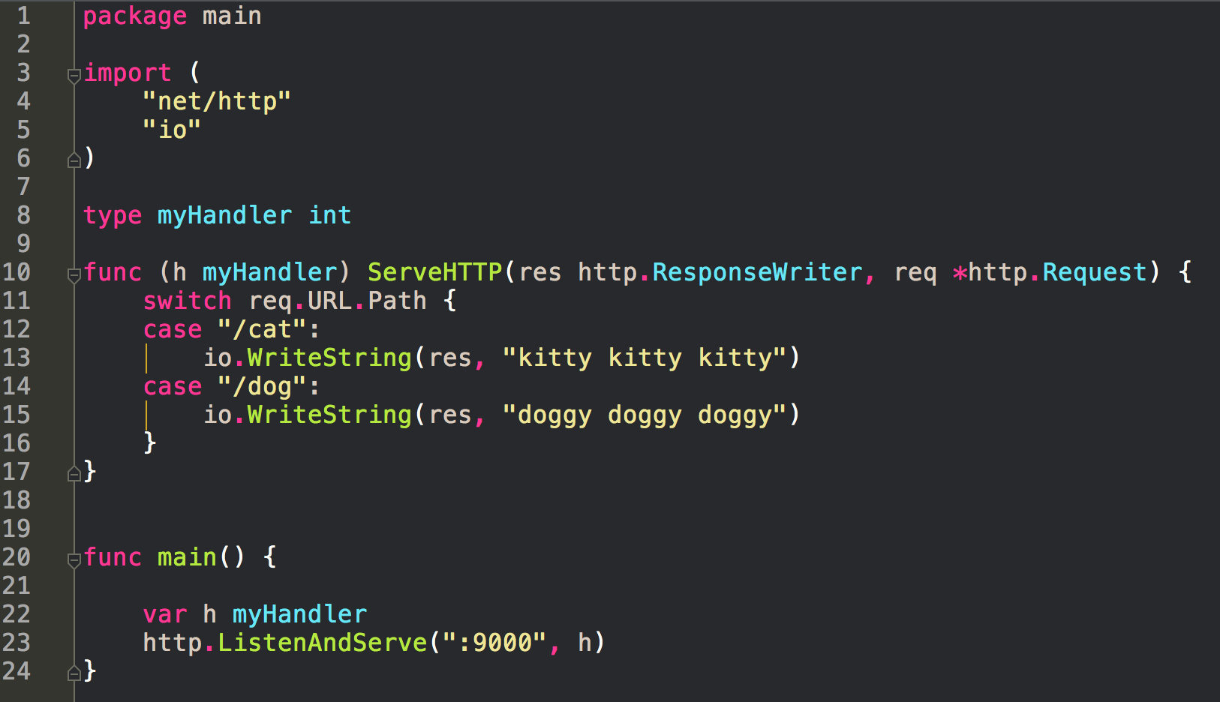
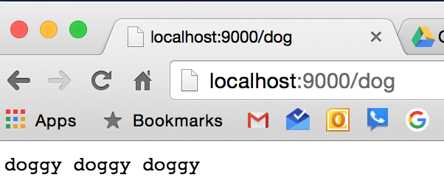
Doing routing like this is tedious ...

Slide 3
servemux
HTTP request multiplexer

Slide 4
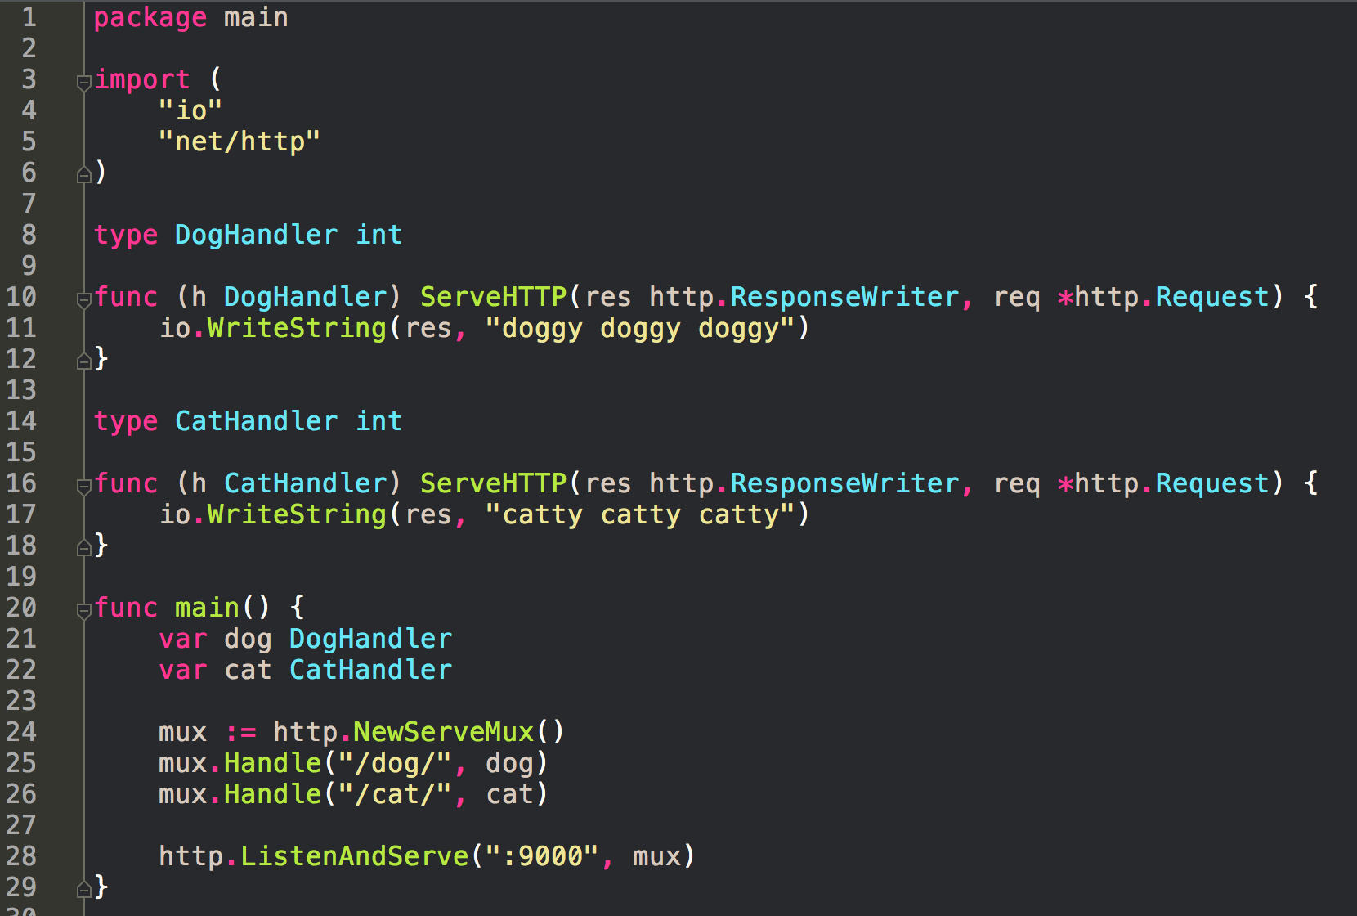
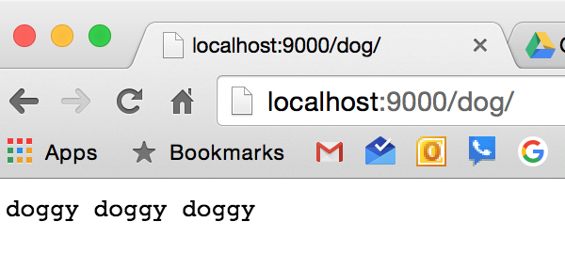
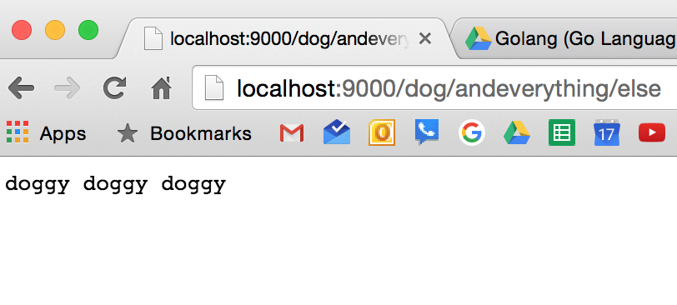

Slide 5
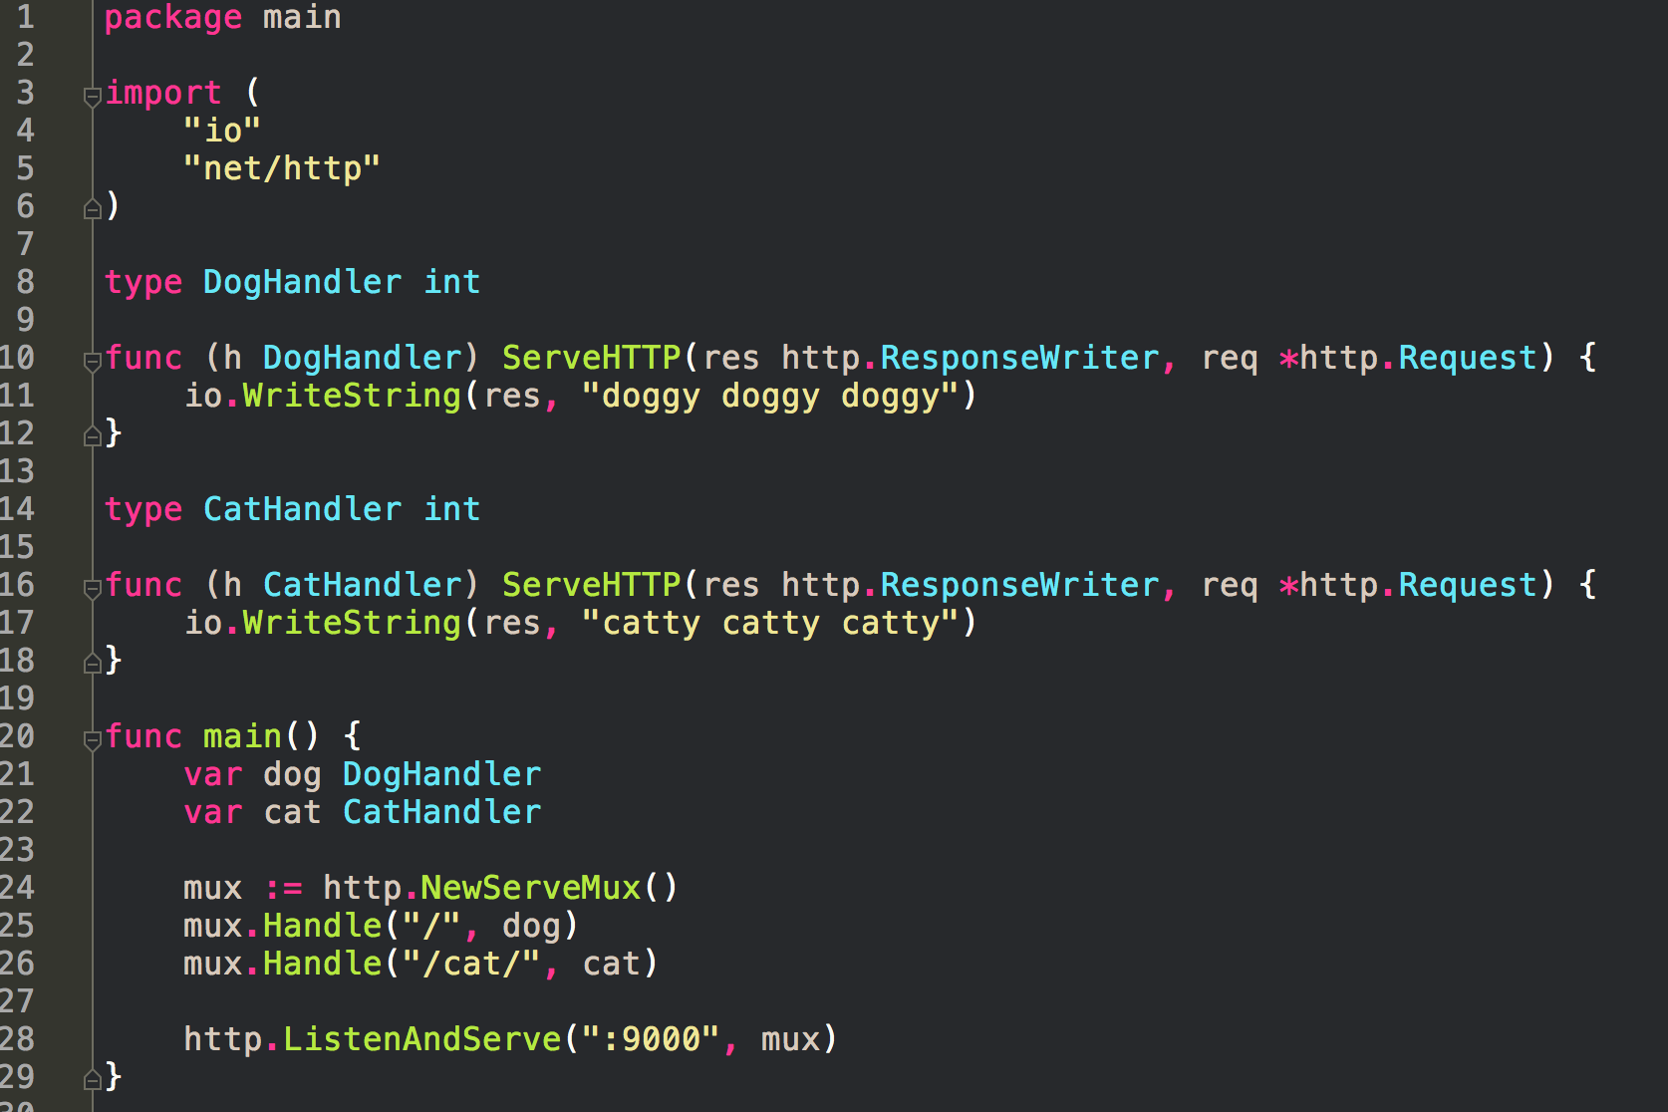

Slide 6
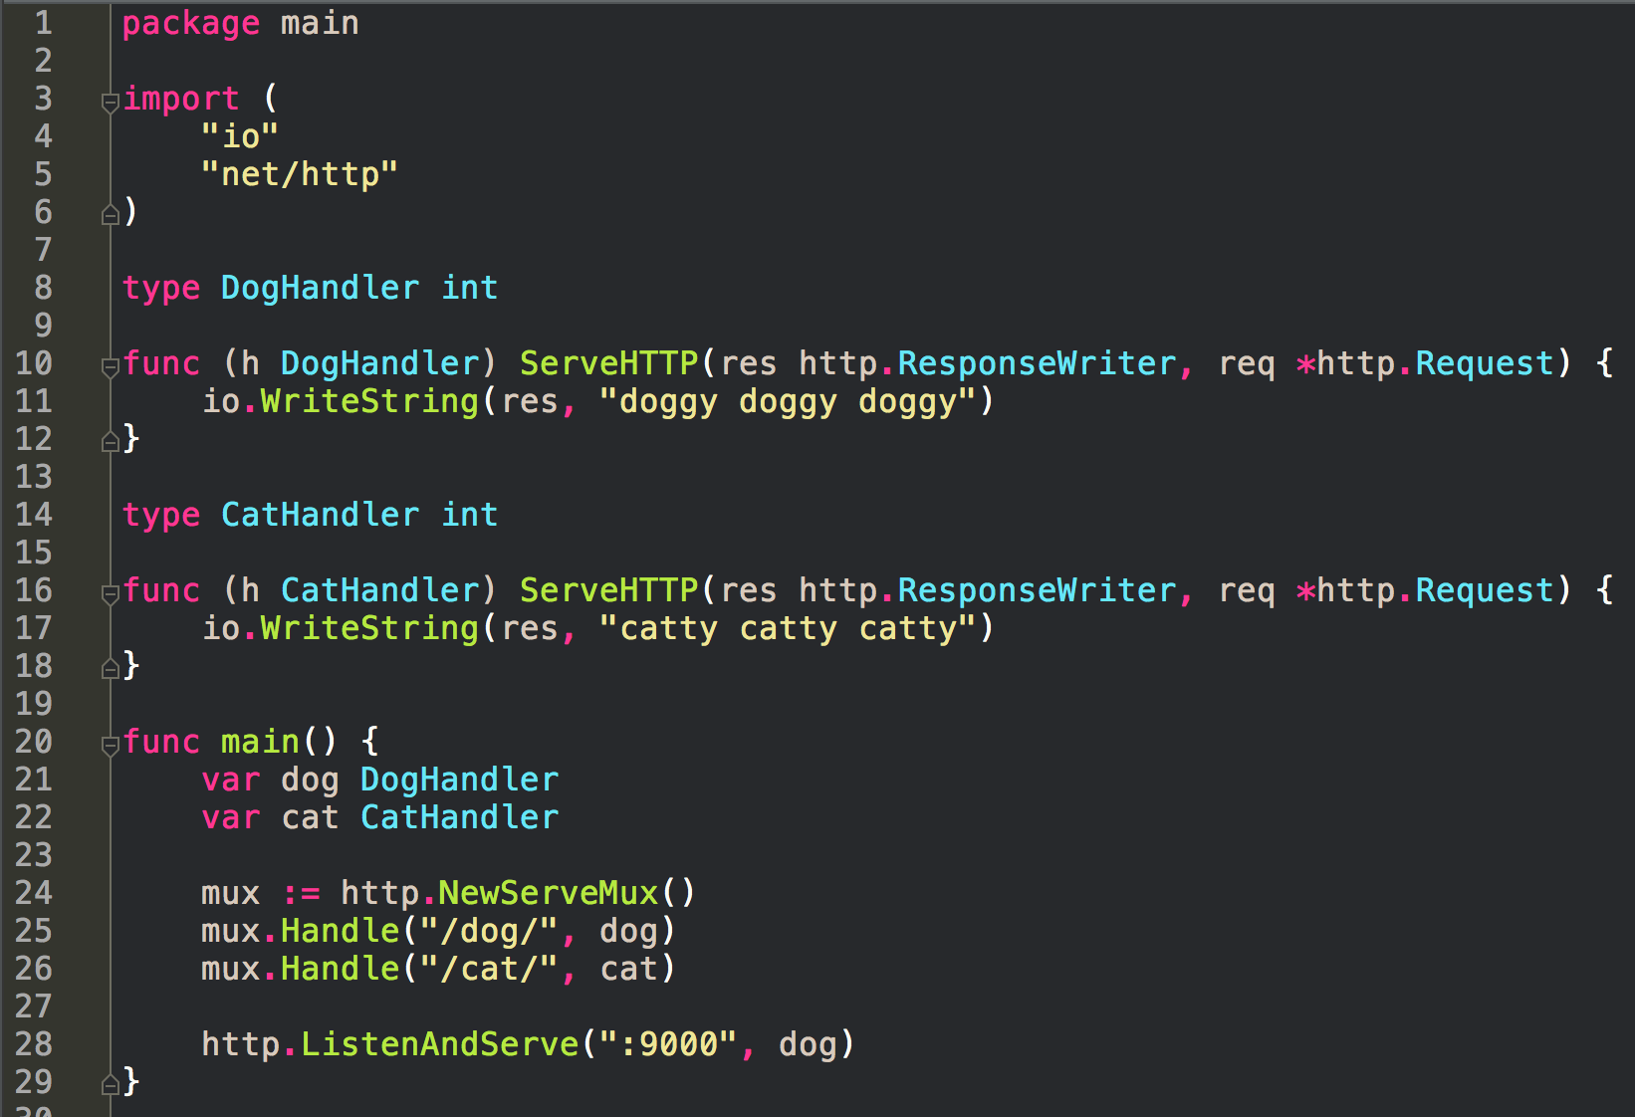
dog is a handler; mux is a handler ListenAndServe takes a handler

Slide 7
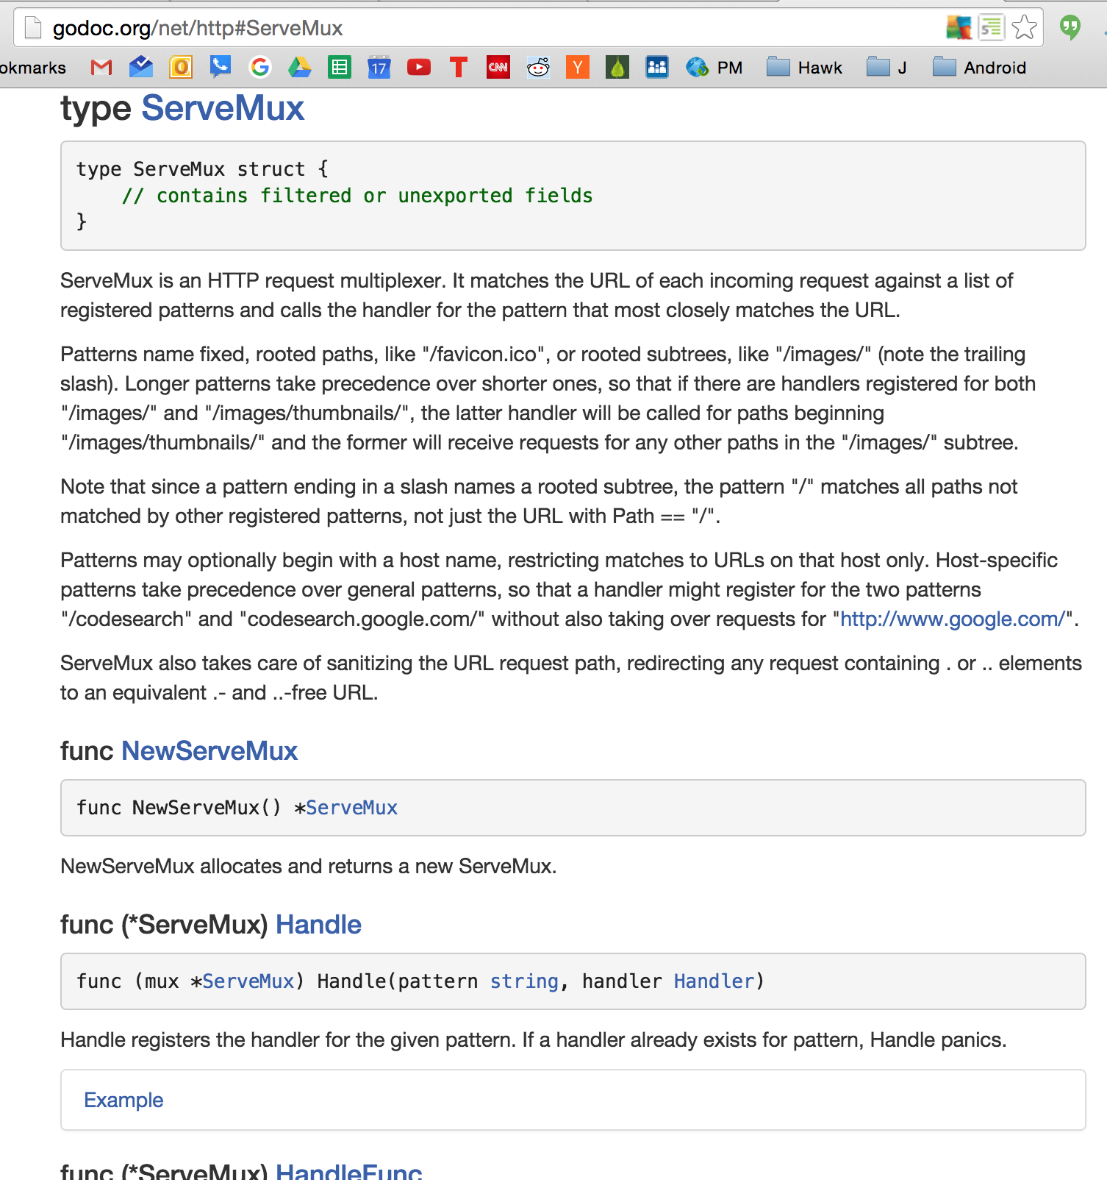
Routing a URL path to some chunk of code

Slide 8
exercise
Create an http server which returns an html page with a picture of a cat for ‘/cat’ and a picture of a dog for ‘/dog’ using a ServeMux

Slide 9
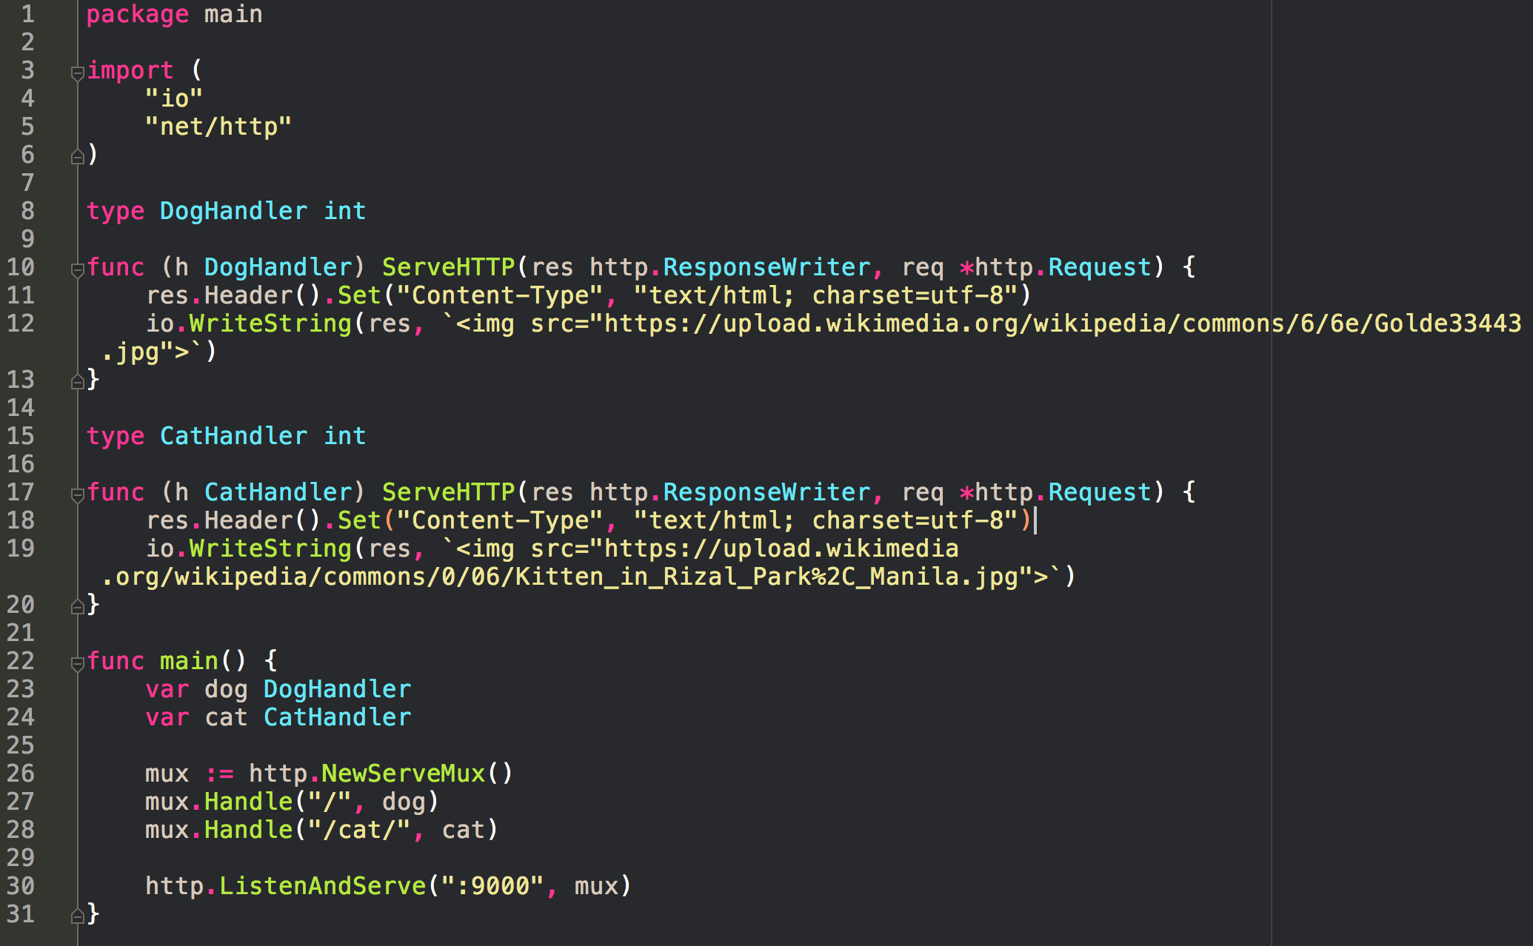

Slide 10
This isn’t too far removed from making a real web page; from how we’re going to do web programming
How we render HTML will be a little different;
we’ll use templates which will be stored in separate files
The way we do routing is pretty much like this.

Slide 11
other routers
good to mention
in addition to the standard library ServeMux
there are other third-party routers

Slide 12


Slide 13
https://github.com/julienschmidt/go-http-routing-benchmark

Slide 14


Slide 15
restful web services

Slide 16
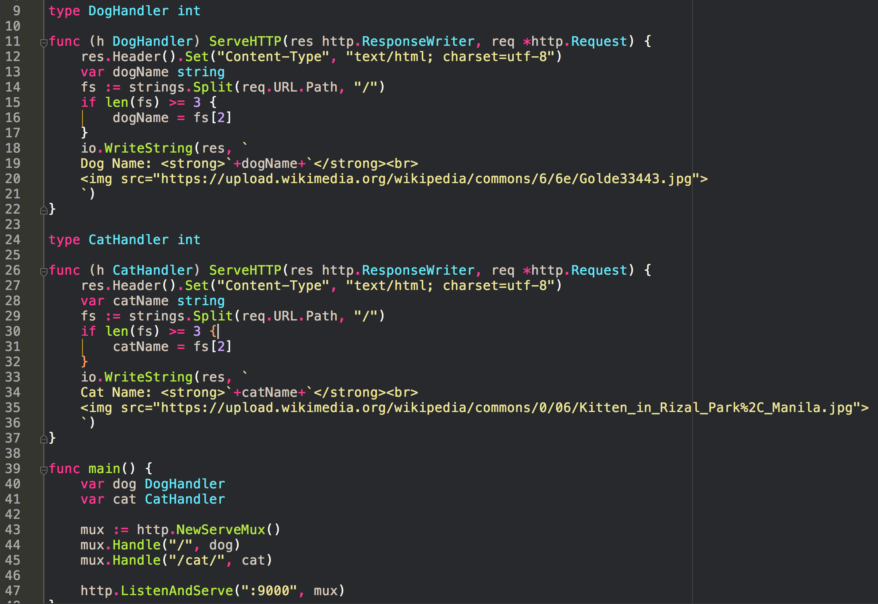
What does this code do?

Slide 17
/dog/toby
0 1 2
length = 3

Slide 18
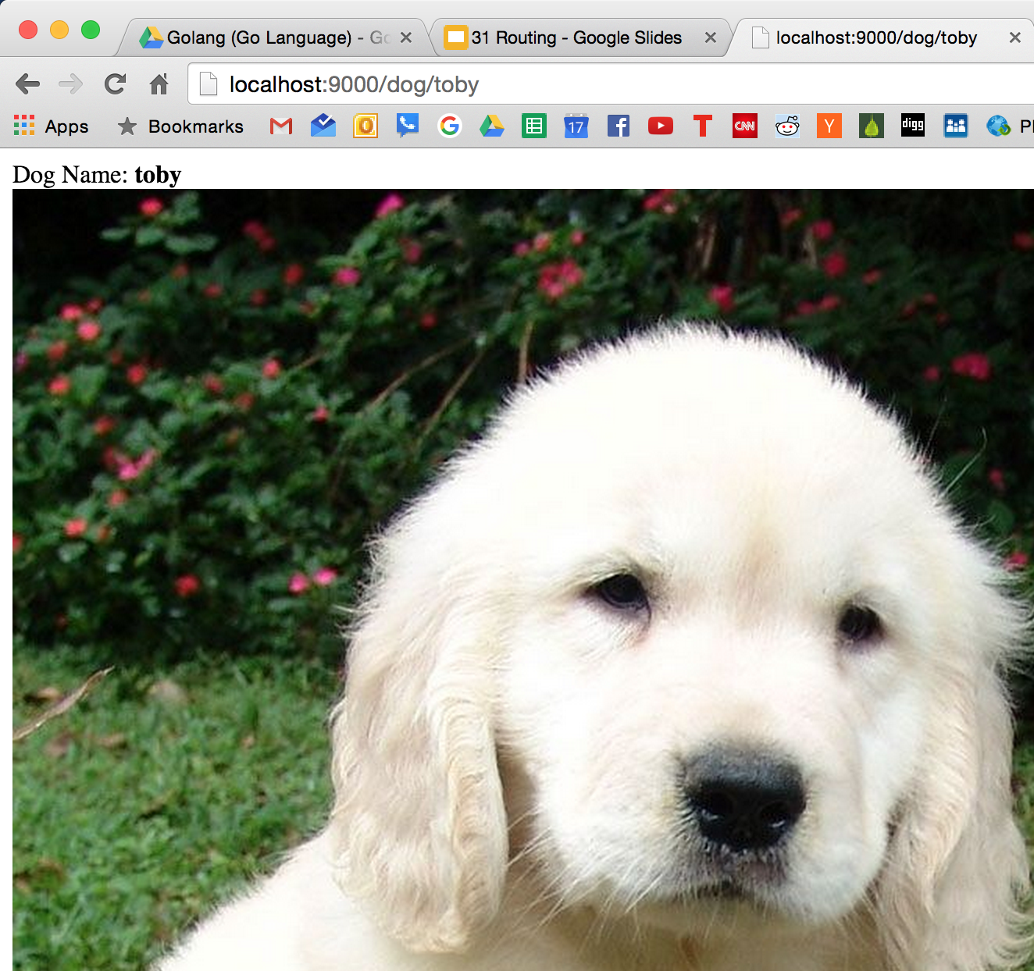


Slide 19
This is RESTFUL

Slide 20


Slide 21


Slide 22


Slide 23


Slide 24
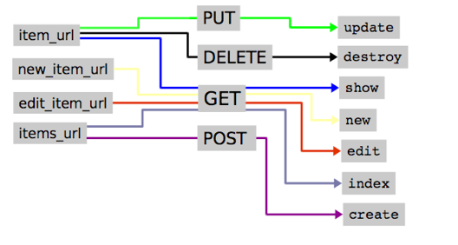

Slide 25
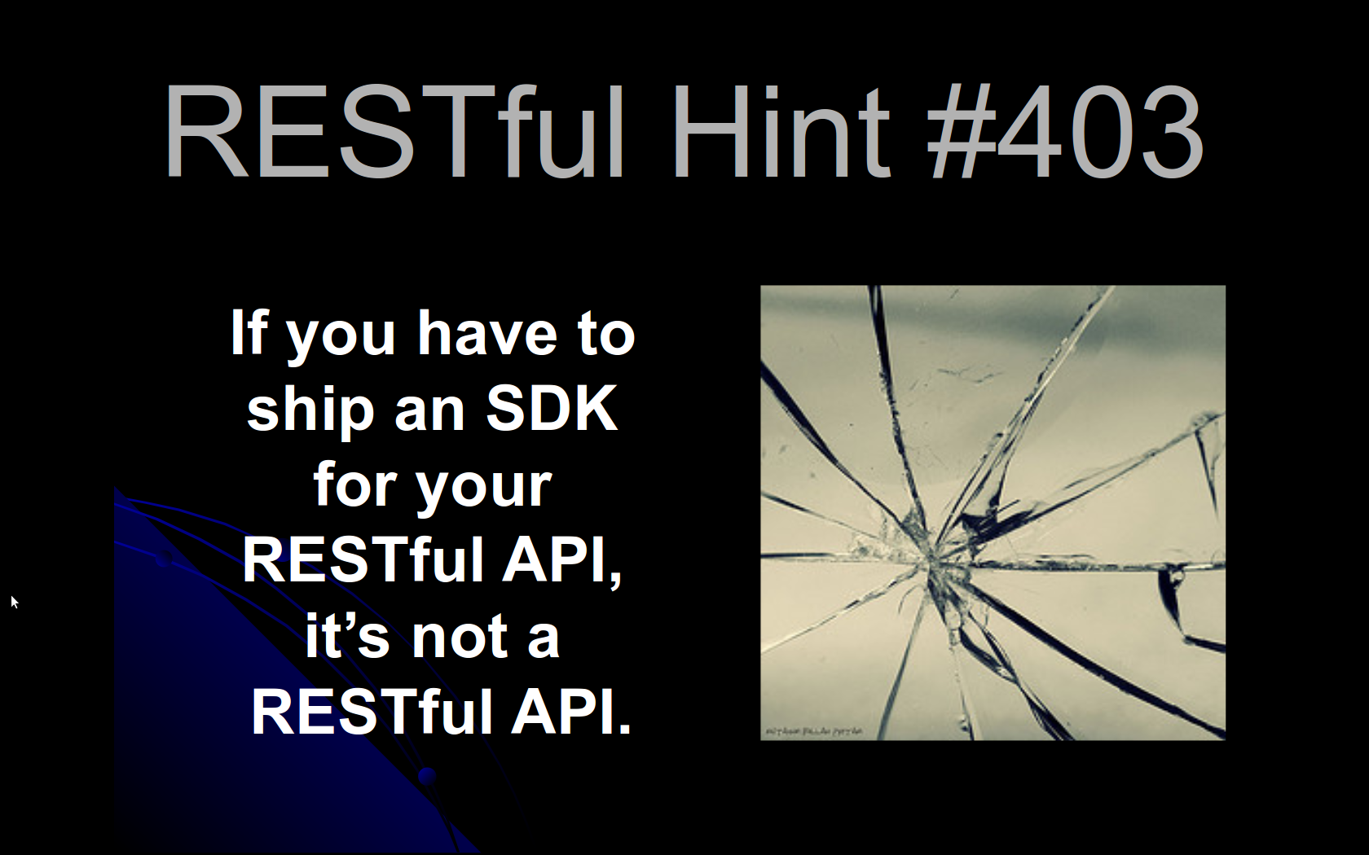

Slide 26
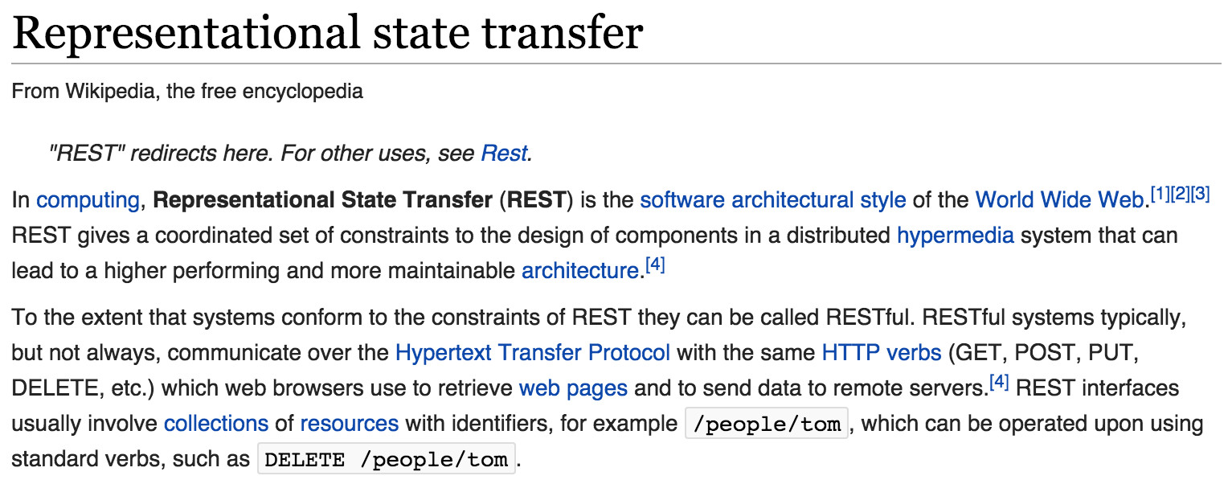

Slide 27
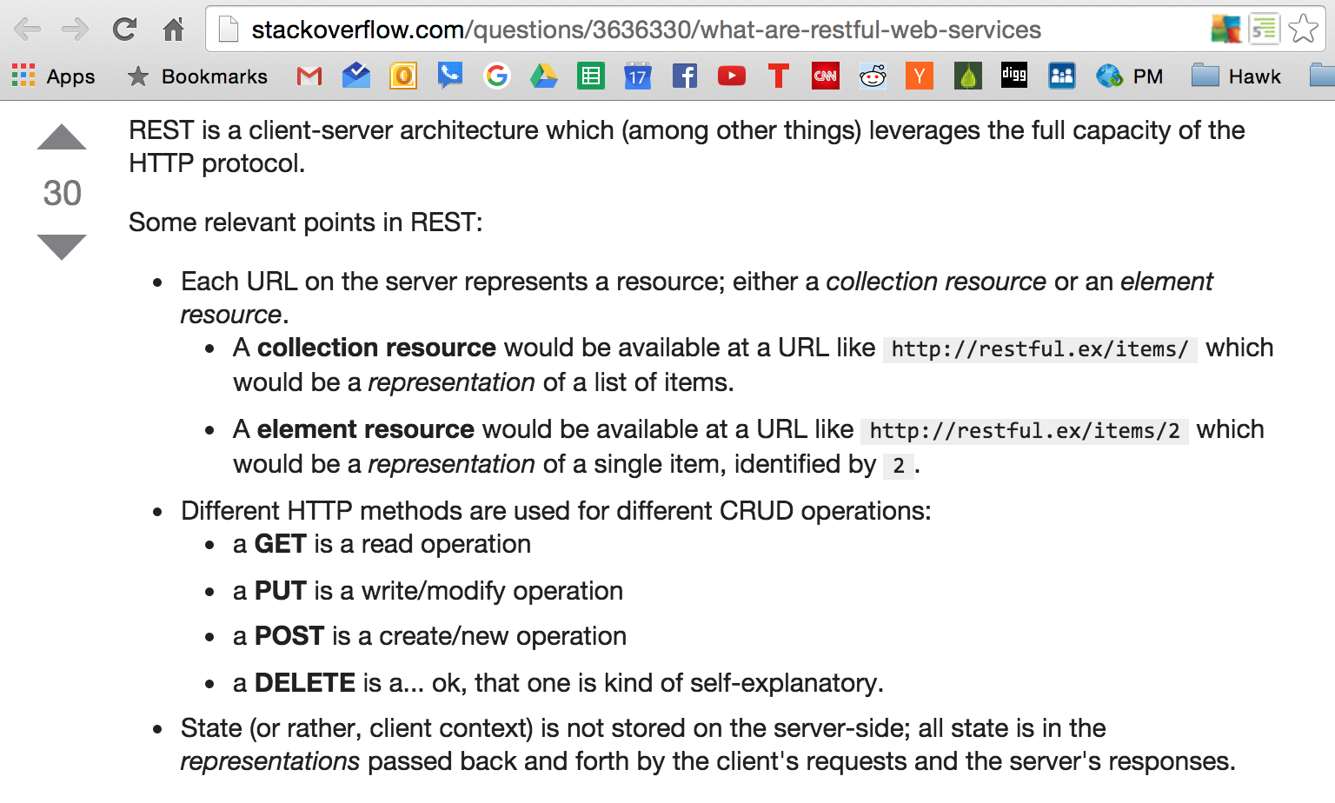

Slide 28
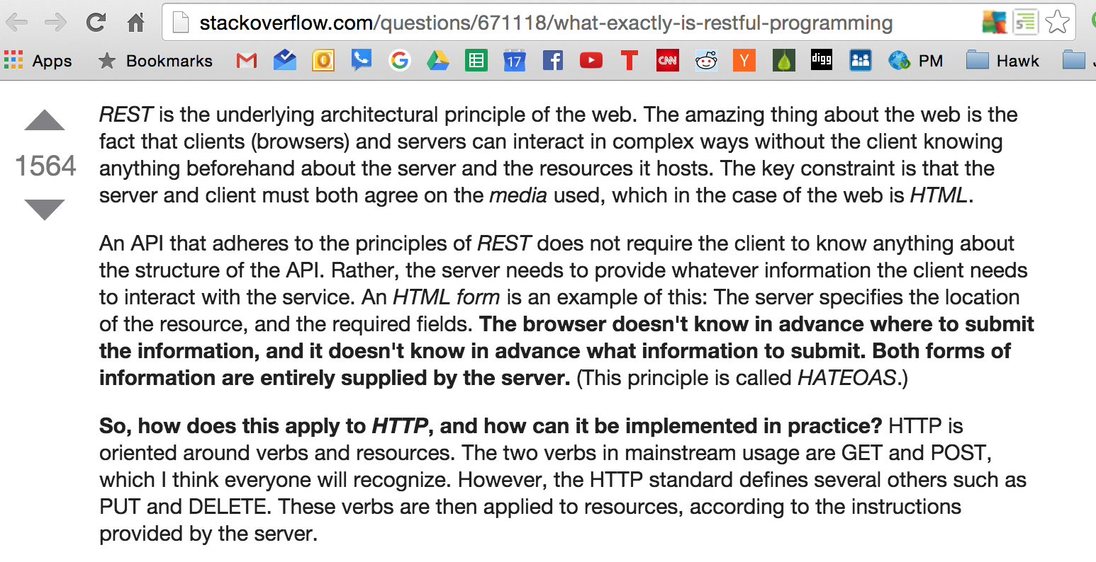

Slide 29
This is RESTFUL

Slide 30
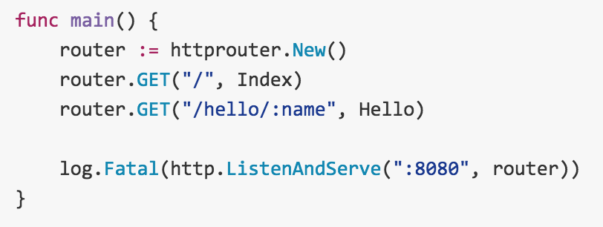
github.com/julienschmidt/httprouter

Slide 31
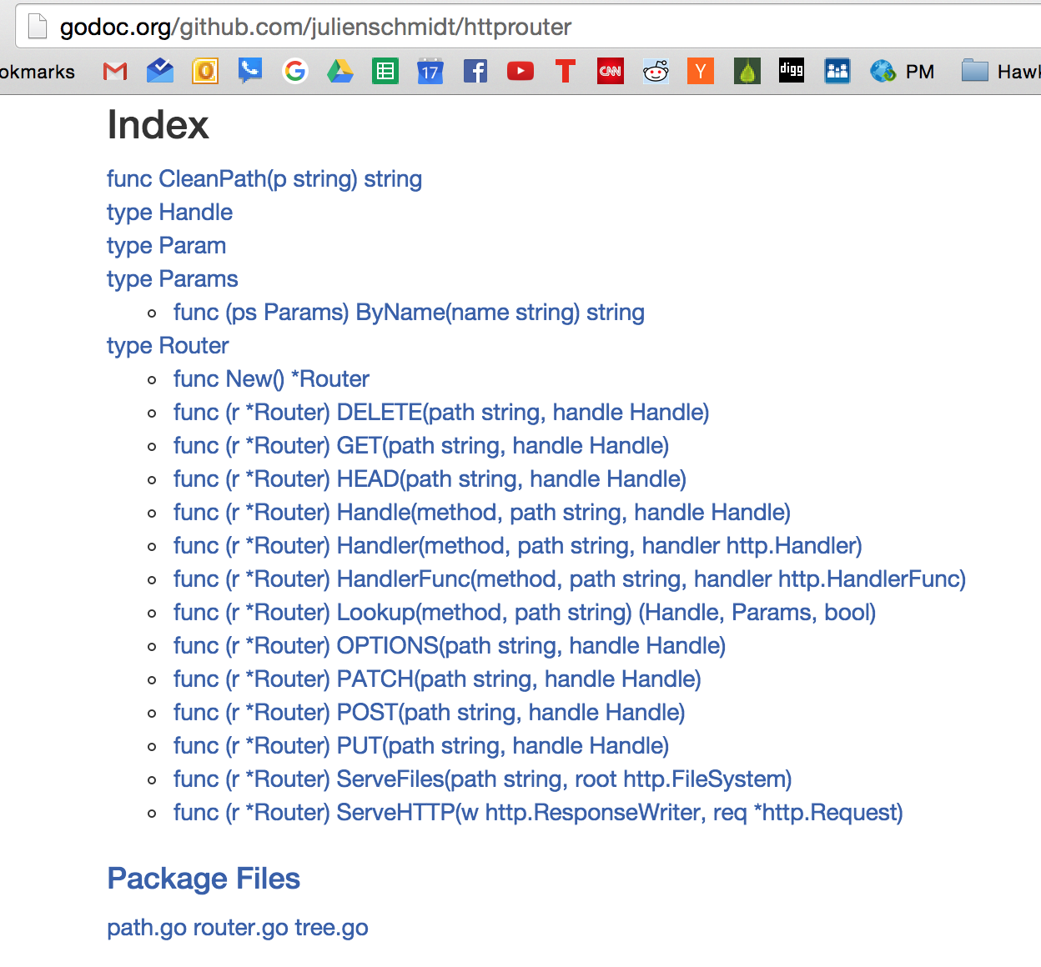
github.com/julienschmidt/httprouter

Slide 32
HandleFunc

Slide 33
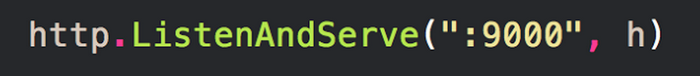
http.ListenAndServe
We looked at this.
func ListenAndServe(addr string, handler Handler) error
a handler implements the handler interface
that means the type has this method:
ServeHTTP(ResponseWriter, *Request)

Slide 34
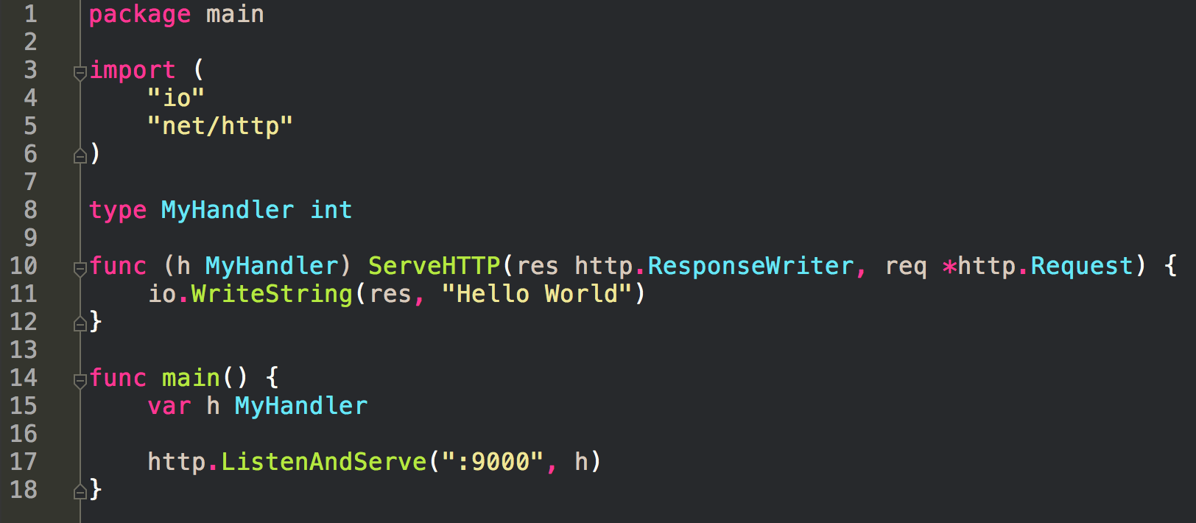
We looked at this.
servers receive requests
and send back responses

Slide 35
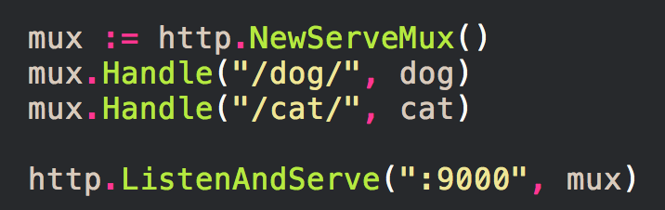
http.NewServeMux()
We looked at this.
ServeMux
a multiplexer
allows us to do routing
*ServeMux.Handle
func (mux *ServeMux) Handle(pattern string, handler Handler)

Slide 36
We looked at this.

Slide 37
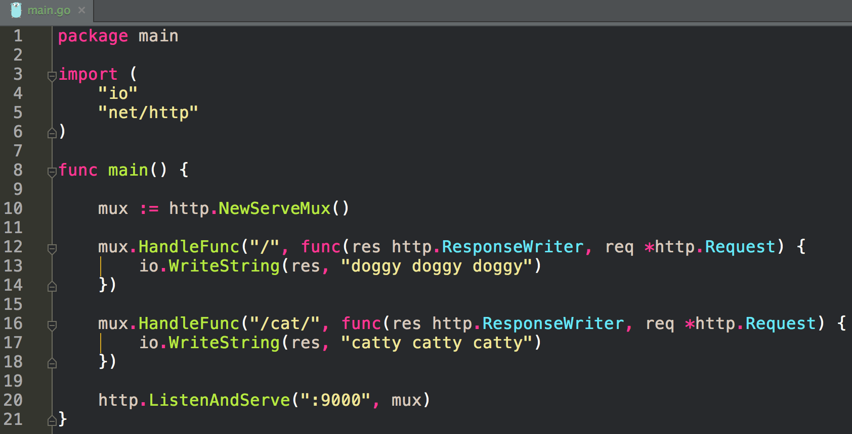
HandleFunc
takes a function
the func needs a specific signature
(res http.ResponseWriter, req *http.request)

Slide 38
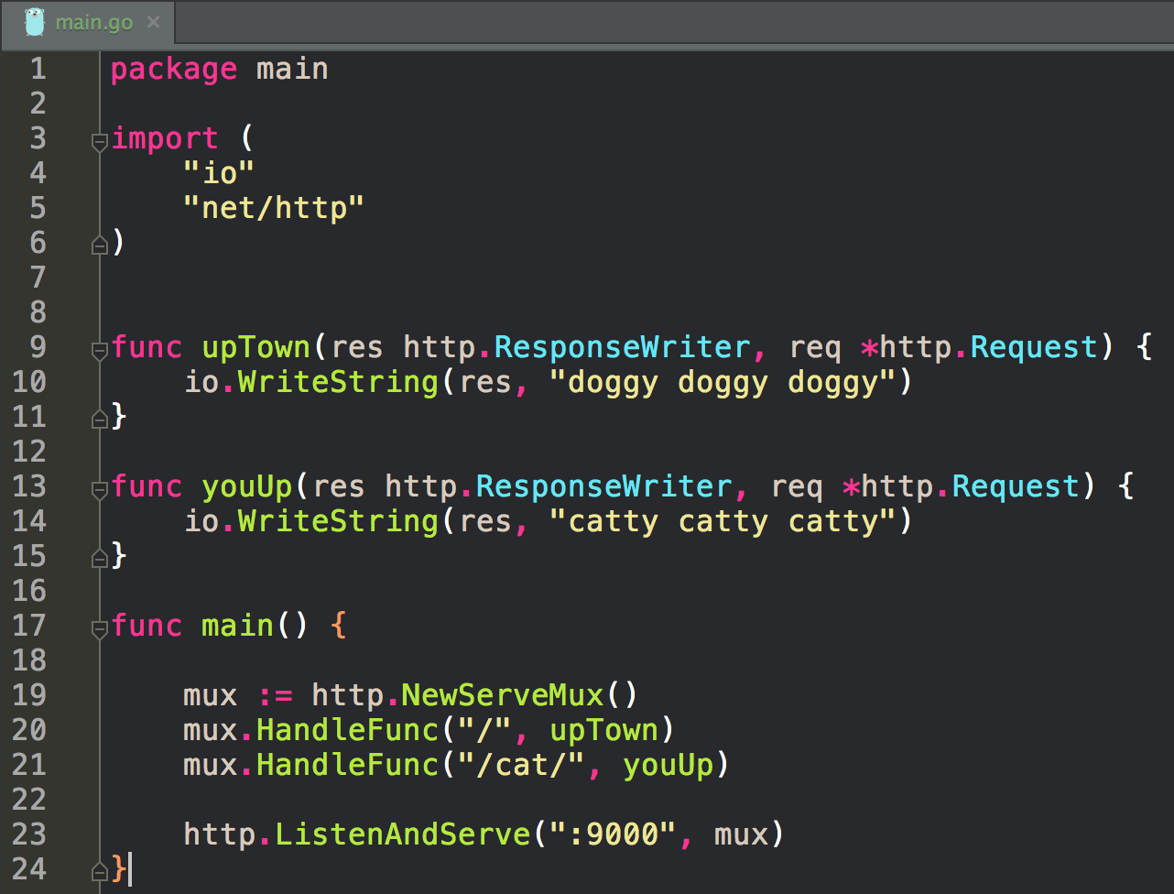
HandleFunc
takes a function
the func needs a specific signature
(res http.ResponseWriter, req *http.request)

Slide 39
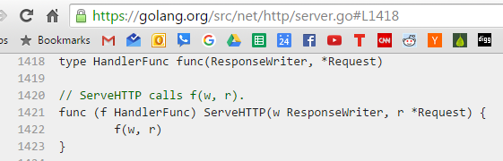
HandlerFunc is of type
func(ReponseWriter, *Request)
The type HandlerFunc
implements the handler interface

Slide 40
HandlerFunc is of type
func(ReponseWriter, *Request)
All it does is invoke itself.
It just calls itself here with two arguments
The type HandlerFunc
implements the handler interface

Slide 41
HandleFunc → HandlerFunc

Slide 42
Handle → Handler

Slide 43
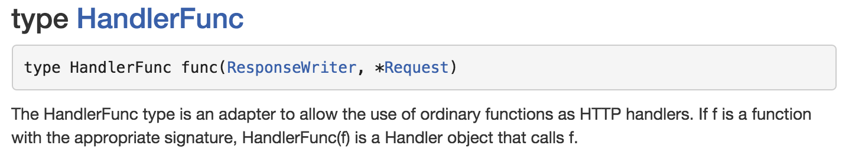
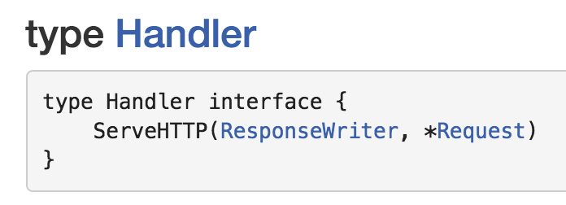
HandleFunc → HandlerFunc
Handle → Handler

Slide 45
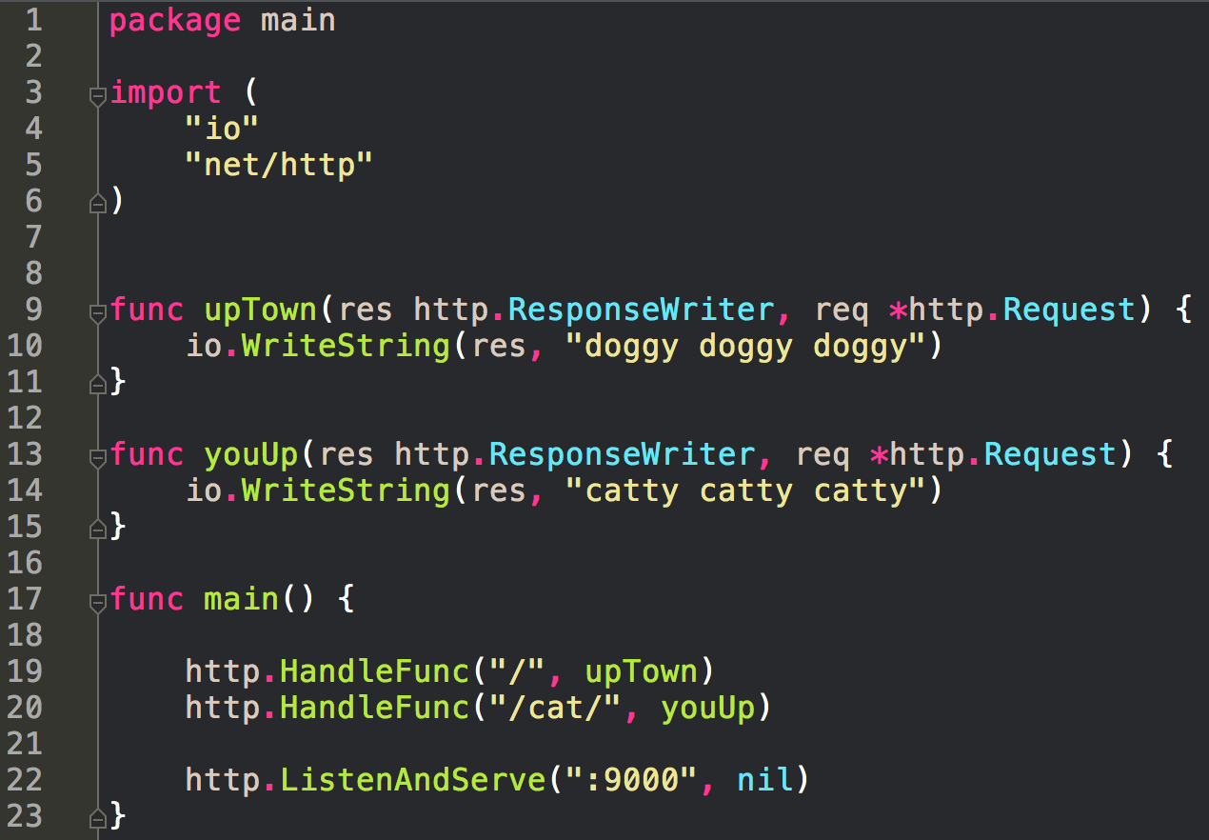
You can also do it like this
Passing nil to ListenAndServe
means the DefaultServeMux is used
var DefaultServeMux = NewServeMux()
we use http.HandleFunc now
instead of *ServeMux.HandleFunc

Slide 46
Building Web Apps in Go
We have a bunch of routes
For each of those routes
we call a HandlerFunc or Handler
call code that does stuff

Slide 47
review

Slide 48
http.ListenAndServe
func ListenAndServe(addr string, handler Handler) error
a handler implements the handler interface
that means the type has this method:
ServeHTTP(ResponseWriter, *Request)

Slide 49
servers receive requests
and send back responses

Slide 50
http.NewServeMux()
ServeMux
a multiplexer
allows us to do routing
*ServeMux.Handle
func (mux *ServeMux) Handle(pattern string, handler Handler)

Slide 52
Restful

Slide 53
HandleFunc → HandlerFunc
Handle → Handler

